Slide 1
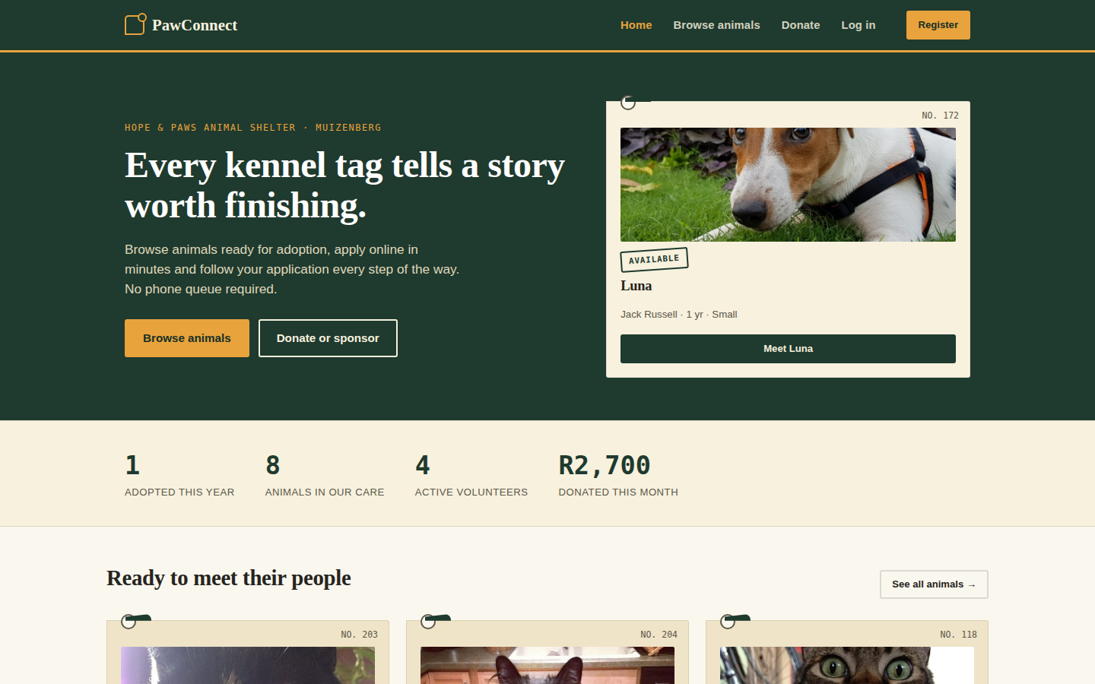
PawConnect
INSY7315 · TASK 2 · IMPLEMENTATION
Adoption, volunteering and donations for Hope & Paws Animal Shelter
Notes:
Presenter: [Member 1]. Introduce the team and the client: Hope & Paws, a small Muizenberg shelter with 5 staff and about 20 volunteers. Say what this presentation covers: a live demo, how we built it, how it is hosted and deployed, and how it meets the requirements from Part 1. Our goal today is the client's approval to go live.

Slide 2




Four problems, four fixes
THE CLIENT'S PROBLEM
Live adoption listing
Online applications
Was: visit in person or message Facebook. Now: filter by species, size, kids and pets.
Was: paper forms retyped into a spreadsheet. Now: submit, review and track online.
Digital medical history
A roster that can't double book
Was: a paper card in the kennel file. Now: searchable records the vet can check remotely.
Was: a WhatsApp group. Now: shift sign up with capacity and clash checks.
PawConnect · Task 2 · 02
Notes:
Presenter: [Member 1]. Recap Part 1 in 30 seconds: these four pain points came from the requirements session with the shelter manager. Each card shows what the shelter did before and what PawConnect does now. Donations and funder reporting are covered too; we'll see those in the admin demo.

Slide 3
One adoption, end to end
LIVE DEMO
1 · ADOPTER
2 · VOLUNTEER
3 · ADMIN
Find and apply
Review and care
Complete and report
Register with POPIA consent
Filter animals live
3 step form, autosaved
Track status and donate
Start review and approve
Log a vaccination
Sign up for a shift
Log hours
Home visit and fee
Mark as adopted
Confirm donations
Export funder CSV
PawConnect · Task 2 · 03
Notes:
Presenter: [Member 2] drives the demo on the LIVE Azure staging site, which has the demo animals and accounts: https://pawconnect-st10285120-staging-g0dzbfbtc8atbfcw.southafricanorth-01.azurewebsites.net (password Demo!Paws2026). Open it a few minutes before presenting so it is awake. Use three browser windows (normal, incognito, second profile) so all three roles are signed in at once. Script: (1) Adopter registers, ticks the consent box, filters Cats + Good with kids, opens a profile, applies (show the draft restoring after a refresh), sees the confirmation reference. (2) Volunteer priya@pawconnect.demo opens the application, Start review, Approve with a note. Open Milo and log a vaccination; the badge flips to Vaccinated. Sign up for a shift, then try an overlapping shift to show it's refused. (3) Admin: record home visit and fee, Mark as adopted, the animal shows Adopted publicly. Reports: export CSV. Keep it to 4-5 minutes. Backup: a screen recording in case the network fails.

Slide 4
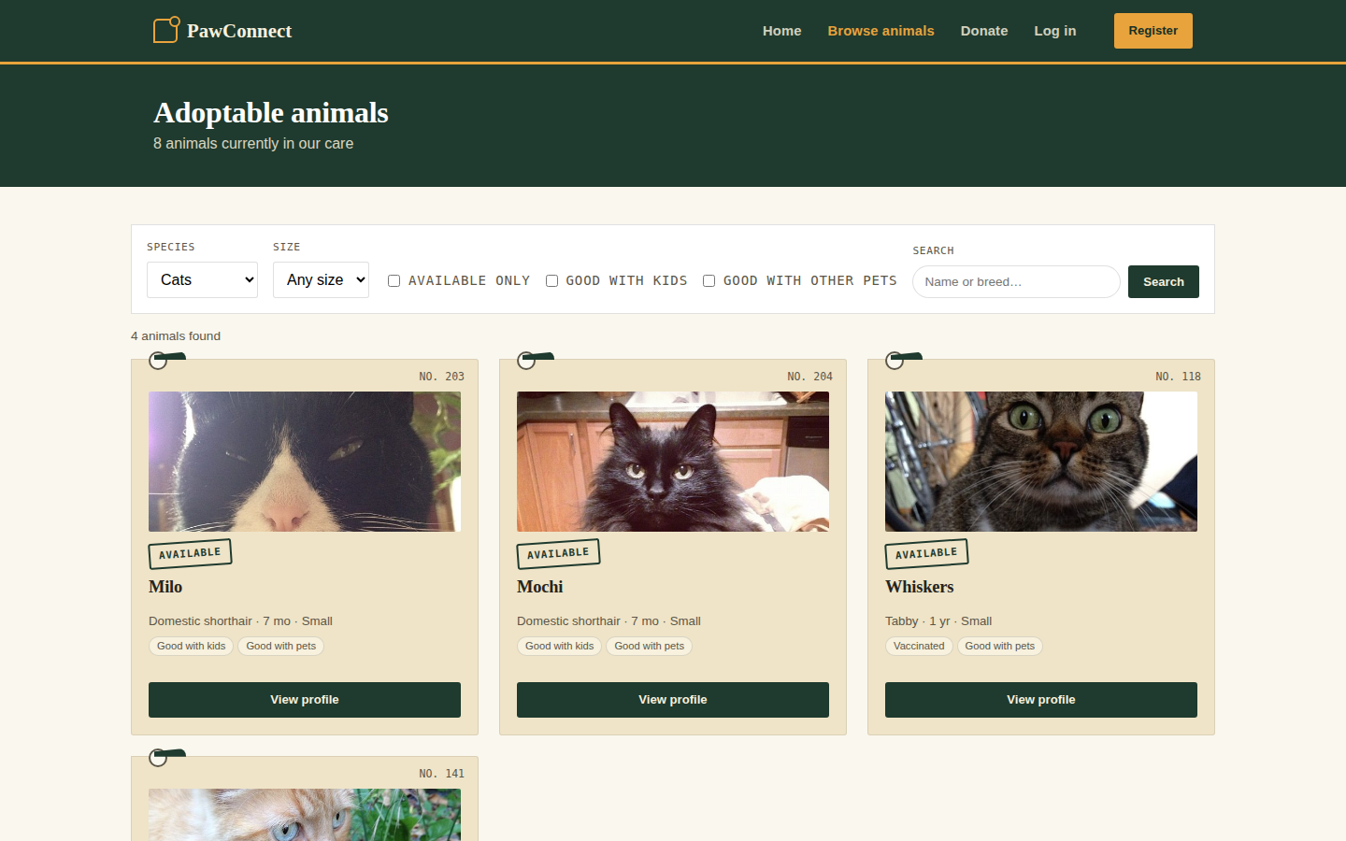
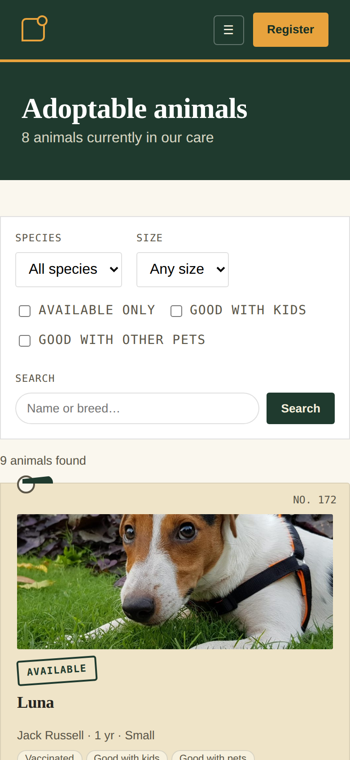
Built for phones and screen readers
FRONT END · PUBLIC SITE
Live filters call GET /api/animals
Clear feedback: spinners, alerts and confirmations
0 violations of WCAG 2.1 AA
Works without JavaScript
PawConnect · Task 2 · 04
Notes:
Presenter: [Member 2]. Front-end rubric points: responsive from 360 px phones to desktop (same page shown on both); accessibility is tested automatically with axe-core on every page, for every role, at desktop and mobile widths, in CI, and the result is zero violations. Mention contrast of at least 4.5:1, labels, skip link, keyboard focus and aria-live result counts. UX feedback: a toast for every action (errors are announced immediately and stay until dismissed), buttons show a spinner and lock while a form is sending so nothing is submitted twice, server errors are marked on the field itself (aria-invalid, read out with the field), confirmations before approving or completing an adoption, autosaved application drafts, and the application status tracker. Demo animals have real photos. Progressive enhancement: filters and forms still work if JavaScript fails.

Slide 5
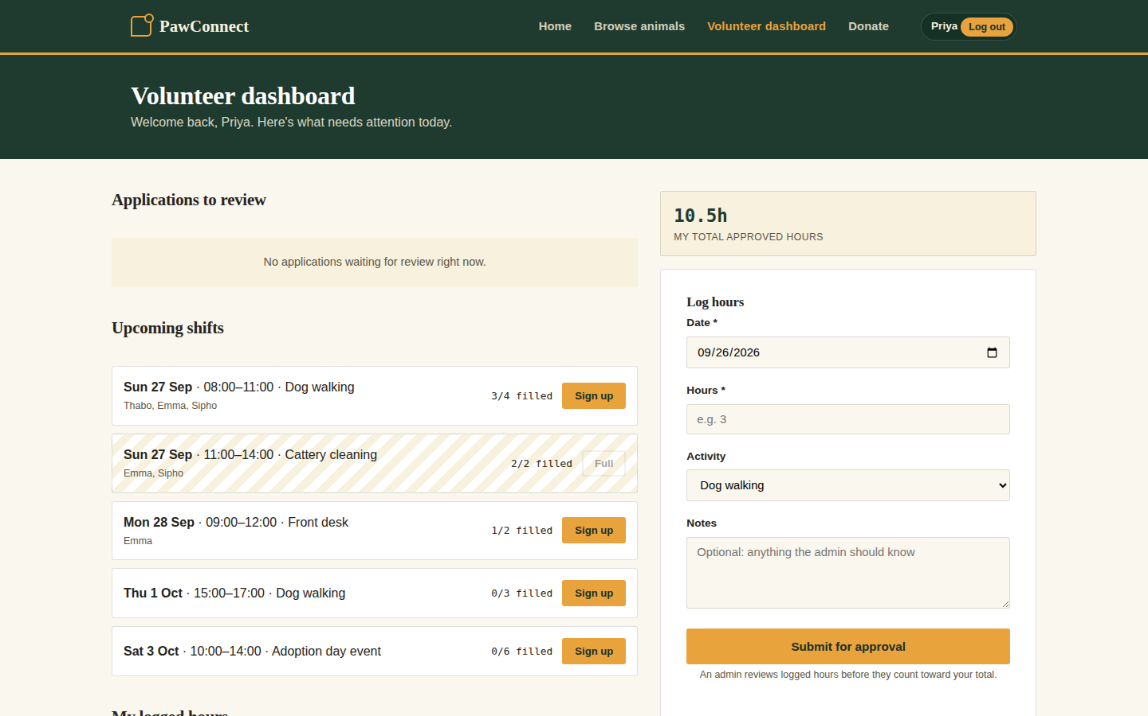
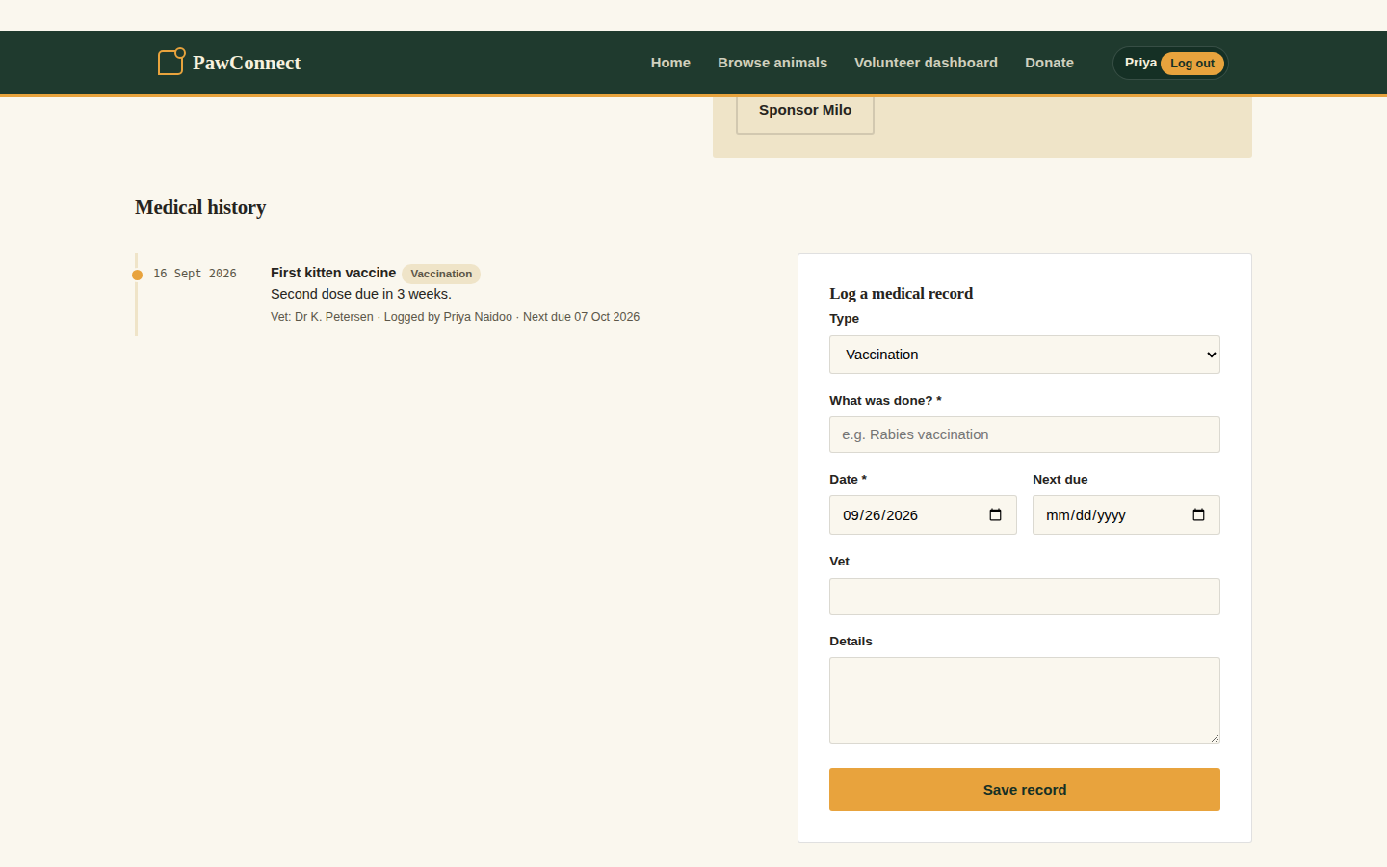
Everything a shift needs
FRONT END · VOLUNTEERS
Review queue, shift roster and hour logging on one screen
Medical history, loaded and saved through the staff only API
PawConnect · Task 2 · 05
Notes:
Presenter: [Member 3]. The volunteer dashboard replaces the WhatsApp group. Full shifts are shown as full, your own shifts are highlighted, and sign-up refuses overbooking and clashes. The medical history panel implements design-doc flow 4.2 exactly: GET /api/animals/{id}?include=history, then POST /api/medical-records. Logging a vaccination updates the public vaccination badge immediately.

Slide 6
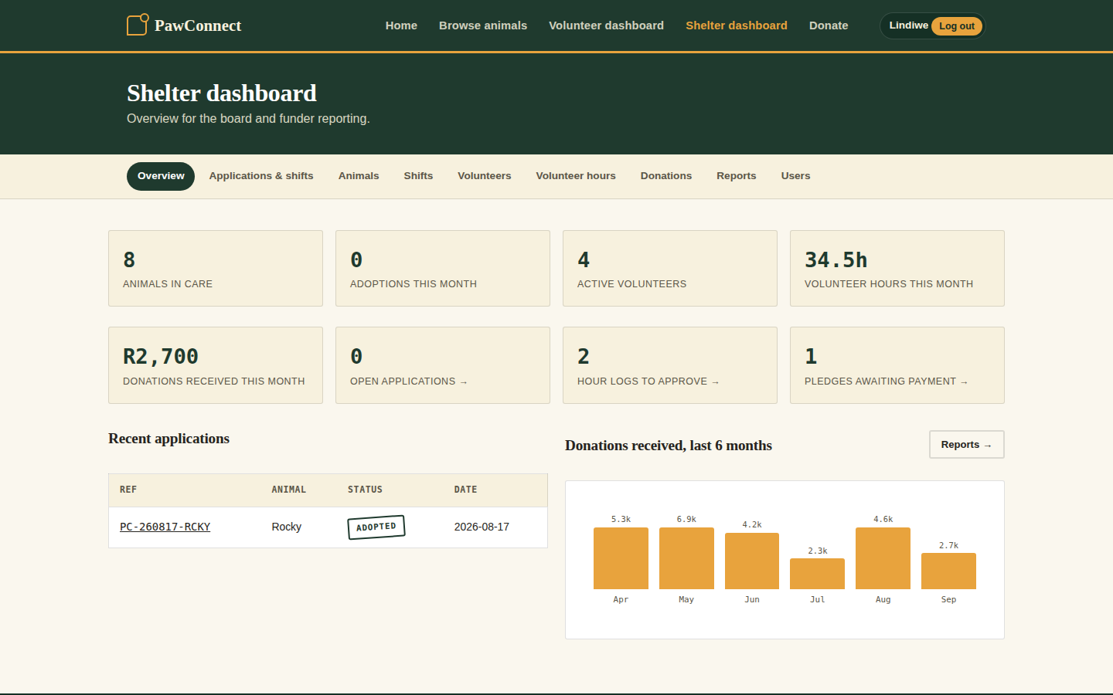
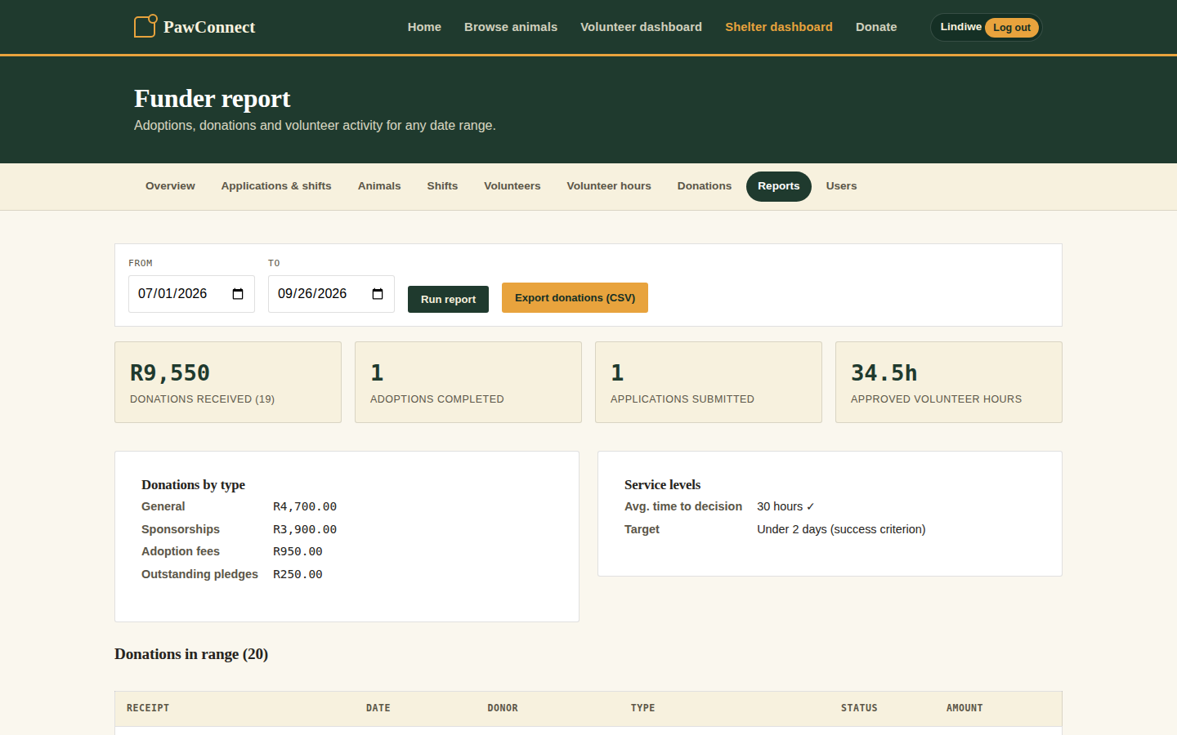
Numbers the board can trust
FRONT END · SHELTER MANAGER
Live dashboard with work queues and a 6 month donations chart
Funder report for any date range and exported as CSV
PawConnect · Task 2 · 06
Notes:
Presenter: [Member 3]. Admin tools: intake with photo upload, shift creation, hour approvals, confirming pledged donations (the donor gets an emailed receipt), user management (create volunteers, change roles, deactivate), and the funder report. The report also shows average time to decision against the success criterion of under 2 days. The CSV export protects against spreadsheet formula injection.

Slide 7
A layered, modular monolith
ARCHITECTURE
Core depends on nothing. Web and data layers plug into it.
PawConnect.Web
MVC pages · REST API · Identity · security middleware
Testable: every rule runs without a database.
PawConnect.Core
Business rules · services · state machine · patterns · interfaces
Cheap: one app, one pipeline and one plan.
PawConnect.Infrastructure
EF Core · repositories · migrations · email channels
PostgreSQL 16
Azure Database for PostgreSQL · Burstable B1ms
PawConnect · Task 2 · 07
Notes:
Presenter: [Member 4]. We compared monolith, microservices and serverless in Part 1 (design doc 6.2) and chose a layered 3-tier modular monolith. The dependency rule: Core has no dependency on EF Core or ASP.NET MVC, so business rules are unit-tested against in-memory repositories, and we could swap the database or UI without touching them. It's one deployable app, which is the cheapest to host for a shelter with a R1,500/month budget, and has no serverless cold starts to break the 500 ms NFR.

Slide 8
The patterns we promised, built
BACK END · DESIGN PATTERNS
Repository + Unit of Work
Strategy: notifications
Services see interfaces, never EF Core. One save per request.
Email by default, SMS when urgent and retry with backoff fallback.
Factory: receipts
State machine
One place builds receipt numbers and wording for page, email and admin.
Only legal status changes happen and guarded server side.
PawConnect · Task 2 · 08
Notes:
Presenter: [Member 4]. These are the three patterns from design doc 6.1, plus the state machine from 4.3. Show code if asked: Core/Interfaces/IRepositories.cs, Core/Notifications/NotificationStrategySelector.cs, Core/Receipts/DonationReceipt.cs, Core/Services/ApplicationStateMachine.cs. Why the Strategy pattern matters to the client: SMS costs money, so it's only used for urgent shift messages; a new channel is one new class with no changes elsewhere.

Slide 9

The adoption lifecycle
BACK END · BUSINESS LOGIC
Submitted
Under Review
Approved
Adopted
Any open state can end in Rejected or Withdrawn. Both are final.
Guarded
In sync
Audited
Adopted only after a home visit and a received fee
The animal goes Pending, back to Available or Adopted automatically
Every change is logged with who and when and the applicant is emailed
PawConnect · Task 2 · 09
Notes:
Presenter: [Member 4]. This is the state diagram from design doc 4.3, now enforced in code by ApplicationStateMachine and AdoptionService. Example: a rejected application can never be marked adopted, and approval is refused unless review has started. The API returns 409 Conflict with a clear message when a transition isn't allowed. Our tests cover every allowed and blocked transition.

Slide 10
Integrity lives in the database
BACK END · DATABASE
Guarantee | How
One open application per animal | PostgreSQL partial unique index
No shift overbooking | Optimistic concurrency token and retry
No double sign-ups | Unique index
No lost updates | Concurrency tokens on applications
Invalid data refused | CHECK constraints on every rule
Safe schema changes | EF Core migrations checked in CI
PawConnect · Task 2 · 10
Notes:
Presenter: [Member 4]. The ERD from Part 1 is implemented in PostgreSQL through EF Core migrations, extended with ShiftSignups, HourLogs, an application audit trail, photos and notifications (full ER diagram in docs/ARCHITECTURE.md). Key point for the database rubric: integrity isn't only checked in code. If two people submit for the same dog at the same instant, the partial unique index rejects the second insert. Shift sign-ups use an optimistic concurrency token, so the last place can't be taken twice. Applications and animals carry a concurrency token too: if a volunteer approves while the adopter withdraws, the second save is refused (409) instead of overwriting. CHECK constraints refuse invalid amounts, hours, capacities and statuses, and partial unique indexes allow one animal per kennel, one adoption fee per application and one cover photo per animal. All of this is proven by tests on a real PostgreSQL database in CI. Money is numeric(10,2), times are UTC, enums are readable text, and deletes are restricted where history matters.

Slide 11
One API for the site and others
BACK END · REST API
Verb | Endpoint | Who
GET | /api/animals?species=&kids= | Public
GET | /api/animals/{id}?include=history | Staff
POST | /api/medical-records | Staff
POST | /api/applications | Adopter
POST | /api/applications/{id}/transitions | Staff
POST | /api/shifts/{id}/signup | Staff
GET | /api/reports/donations.csv | Admin
Correct codes: 201, 204, 400, 401, 403, 409
Errors as RFC 7807 problem JSON
Auth: cookie + CSRF header, or bearer token
PawConnect · Task 2 · 11
Notes:
Presenter: [Member 4]. The browser's own JavaScript uses this API (live filtering and medical records), and so can any other client. The full list of 17 endpoints is in the README, and PawConnect.http in the repo runs them from Rider. DTOs mean internal fields like password hashes and photo bytes never leak. Model validation returns 400; wrong role returns 403; illegal workflow moves return 409 with the reason. Integration tests exercise the API through the real HTTP pipeline.

Slide 12






Secure at every layer
SECURITY · OWASP TOP 10 + POPIA
Access control
Authentication
CSRF and XSS
Roles on every endpoint; own records and own branch only
Salted hashes, lockout after 5 tries, rate limiting
Anti-forgery tokens; strict CSP with no inline script
Injection
Secrets
POPIA
Parameterised SQL; validated input; safe CSV export
Key Vault + managed identity; nothing in Git
Consent, privacy notice, download my data
PawConnect · Task 2 · 12
Notes:
Presenter: [Member 3]. This maps to the OWASP table in the design doc (7.3). Offer to prove it live: call /api/animals/{id}?include=history without signing in (401) and as an adopter (403). Other points: images are checked by their bytes, not their name; the CI build fails if any NuGet package has a known vulnerability; deactivated users are locked out and their sessions end within 5 minutes; and there are integration tests for lockout, CSRF, role checks, and for changing an id to reach someone else's application or donation (404, so ids can't even be probed).

Slide 13


Live on Azure, in South Africa
HOSTING · MICROSOFT AZURE
GitHub Actions · deploys with publish profiles kept as secrets
Running now in production and staging
Firewalled database only our apps
App Service (.NET 8, HTTPS only)
Every release checked live
Staging app · demo data
Production app · real data
Bicep + S1 adds slots, Key Vault and App Insights
PostgreSQL
one database each
App settings
secrets, not code
/health
and /version
PawConnect · Task 2 · 13
Notes:
Presenter: [Member 5 / DevOps lead]. What is live today: two Azure App Service web apps in South Africa North (production on main, staging on develop), each with its own database on one Azure Database for PostgreSQL flexible server. Connection strings and the admin password are app settings, never in the code or GitHub. The database firewall only lets our web apps in. Why App Service: fully managed (patching, TLS, scaling), native .NET 8 support, and South Africa North keeps personal data in the country (POPIA). Our student Azure account blocks Entra app registrations, so GitHub deploys with publish profiles stored as GitHub secrets instead of OIDC. The full target design is in infra/main.bicep: on the S1 plan it adds blue-green deployment slots with automatic rollback, Key Vault and Application Insights with alerts, from one script (scripts/azure-setup.sh). Cost: S1 is about US$70/month; the free/basic plans we use for the demo have no slots, so staging is a separate app. Show /health and /version on the live site. A free Render + Neon setup is documented as a fallback (docs/DEPLOYMENT-FREE.md).

Slide 14







Gitflow, every change reviewed
GITHUB · BRANCHING
Protected main and develop
main
→ live
1 approval + green CI to merge
Conventional commit messages
develop
Dependabot weekly updates
→ staging
feature/*
PR + review + CI
PawConnect · Task 2 · 14
Notes:
Presenter: [Member 5]. Show the real GitHub repository: the network graph (Insights → Network), a merged pull request with its review and green checks, and the branch protection rules. Explain the flow: feature branches from develop, PRs back into develop (which deploys to staging), then a release PR from develop to main (which deploys to production after approval). Point to CONTRIBUTING.md for the rules and the ownership split. Screenshot for the slide: [paste your GitHub network graph here if you want].

Slide 15

From pull request to production
CI/CD · GITHUB ACTIONS
1 · EVERY PR
2 · DEVELOP
3 · MAIN
4 · VERIFY
CI gate
Staging
Approval
Checked live
Build
132 tests, coverage ≥ 70%
Vulnerable package scan
Migration check
Accessibility audit
Deploy to staging app
Wait for new commit
Smoke test 5 URLs
Demo to the client
Required reviewer
Deploy to production
Exact commit on /version
Health check
S1: swap, auto rollback
PawConnect · Task 2 · 15
Notes:
Presenter: [Member 5]. Show the Actions tab: a green CI run (open the job summary to show the 84.3% coverage report), and a Deploy run on main showing the approval gate, the production deploy and the health check. A release only counts as done when the live site reports the exact commit we built on /version and /health says Healthy, so a deploy that uploads but doesn't start is caught and the run goes red. That happened to us once: the run failed, we fixed the database firewall and re-ran it. On the S1 plan the same workflow deploys to a staging slot, swaps it into production and swaps back automatically if the health check fails. This is the design doc's 8.2 pipeline, implemented as .github/workflows/ci.yml and deploy.yml. The rubric's top band asks us to "demonstrate automated testing and deployment success"; this is where we do it.

Slide 16
Proven by automation, not promises
QUALITY EVIDENCE
132
0
109
0
automated tests, incl. real PostgreSQL
WCAG 2.1 AA violations on 46 page checks
ms worst p95; the target is 500 ms
known-vulnerable packages allowed by CI
PawConnect · Task 2 · 16
Notes:
Presenter: [Member 5]. Each number is enforced by the pipeline, not just measured once. 132 tests run on every PR: unit tests for the patterns, service tests against real repositories, integration tests that boot the whole app (including access-control tests: another user or another branch gets 404), and 13 tests on a real PostgreSQL database that prove the constraints and concurrency rules with two users acting at the same moment. CI fails if line coverage drops below 70%. The accessibility audit runs axe-core on every page for every role on desktop and mobile. p95 of 109 ms is from a local load test (300 requests, 10 concurrent); replace it with the Azure figure from Application Insights once live: [Azure p95]. Coverage from the CI job summary: 84.3% line coverage overall (Core 93.1%, Infrastructure 91.2%, Web 72.1%), above the 70% gate.

Slide 17
Every Part 1 requirement, traced
REQUIREMENTS ALIGNMENT
From the design document | Delivered | Evidence
Adopter user stories | 5 of 5 | Service andAPI tests
Volunteer user stories | 5 of 5 | Service and API tests
Administrator user stories | 5 of 5 | Service and account tests
Acceptance criteria | 4 of 4 | Workflow tests
Non-functional requirements | 11 of 11 | Tests, auditand load test
Full matrix: docs/REQUIREMENTS-TRACEABILITY.md in the repository
PawConnect · Task 2 · 17
Notes:
Presenter: [Member 1]. The traceability document maps each user story, acceptance criterion and NFR from Part 1 to where it's implemented and the named test that proves it. The volunteer-hours stories came from our prototype and are counted in the 5 volunteer and 5 admin stories. Success criteria are supported too, for example the report's average time to decision against the 2-day target, and zero double bookings enforced by the database. The NFR count includes accessibility, which the front-end rubric asks for.

Slide 18
What changed, and why
DECISIONS AND CHALLENGES
ASP.NET Core, not React + Express
ASP.NET Identity, not Azure AD B2C
Built on our Part 1 prototype, one language end to end and one deployable app.
B2C closed to new customers; Identity is free and gives lockout and roles.
Two volunteers, one last place
Tests caught a real bug
Solved with a concurrency token and retry and proven by a race condition test.
The audit trail saved as UPDATE, not INSERT. Found by end to end tests fixed before release.
PawConnect · Task 2 · 18
Notes:
Presenter: [Member 4]. Be open about the stack change: Part 1 planned React + Express + Azure AD B2C, but our prototype was ASP.NET Core, and Microsoft stopped selling B2C to new customers in 2025. The design document is updated in Task 3 (docs/TASK3-DOC-UPDATES.md). Other challenges worth mentioning: a strict Content-Security-Policy meant rewriting inline onclick handlers into site.js; and deployment slots need the S1 tier, which affected the cost plan (B1 and free F1 fallbacks are built into the Bicep and the pipeline). A code review against the rubric also led us to add branch scoping for volunteers, concurrency tokens on applications, database CHECK constraints, and PostgreSQL tests in CI. Bug story: EF Core treats a new child row with a preset GUID key as an existing row; our browser tests caught it and the fix lets EF generate the key.

Slide 19
Four problems we solved on Azure
GOING LIVE
No rights to create an identity
The pipeline checked the wrong address
Student accounts block app registrations so we added a publish profile deploy mode.
New Azure apps get a unique hostname. The real URLs are now pipeline variables.
App crashed on start-up (500.30)
CI blocked vulnerable packages
The database firewall blocked the app. Kudu showed the error; firewall rules fixed it.
The scan flagged two library versions. We pinned the patched releases.
PawConnect · Task 2 · 19
Notes:
Presenter: [Member 5]. The point of this slide: the pipeline's checks did their job. (1) Creating the GitHub identity in Microsoft Entra returned "You don't have access" on our student account, so deploy.yml got a second mode using publish profiles stored as GitHub secrets (documented in docs/DEPLOYMENT.md). (2) The first staging deploy uploaded fine, but the "wait until this build is running" step timed out: Azure now gives new apps a unique default domain (name-hash.southafricanorth-01.azurewebsites.net), so we added AZURE_WEBAPP_URL variables. (3) The site then showed HTTP 500.30. Running the app in the Kudu console printed the real error, a timeout connecting to PostgreSQL on port 5432: the database firewall was blocking the web app. After adding firewall rules it applied all three migrations, seeded the demo data and started. Production had the same issue; the pipeline went red, we fixed it and re-ran the failed job. (4) The CI vulnerable-package scan failed on transitive System.Text.Json and Microsoft.Extensions.Caching.Memory versions; we pinned the patched 8.0.x releases. Every one of these was caught by an automated check, not by a user.

Slide 20
Ready for your approval
OUR REQUEST
PawConnect is live on Azure, in production and staging and passes every automated check.
Next: UAT
Then: training
Go live
Shelter manager and two volunteers
User guide and a 1 hour session
Two weeks in parallel, then switch · questions?
Production pawconnect-st10285120-fbfcdpfnf5g2h0bk.southafricanorth-01.azurewebsites.net
Staging pawconnect-st10285120-staging-g0dzbfbtc8atbfcw.southafricanorth-01.azurewebsites.net
Notes:
Presenter: [Member 1]. The rubric frames this presentation as obtaining the client's approval to implement, so ask for it directly. Summarise: all Part 1 requirements delivered and tested; secure; running on Azure in South Africa North, with production released only after approval and a live health check. Production: https://pawconnect-st10285120-fbfcdpfnf5g2h0bk.southafricanorth-01.azurewebsites.net (starts empty, only the administrator). Staging, with demo data: https://pawconnect-st10285120-staging-g0dzbfbtc8atbfcw.southafricanorth-01.azurewebsites.net. Next steps from the change-management plan: UAT with the shelter manager and two volunteers, the user guide and training, parallel running with the spreadsheet for two weeks, then go live. Invite questions; the likely ones are on security, the stack change and cost.

